Slide 1
Practice Session 8
Human Role in Mutual Enrichment (Harmony) in Nature

Slide 2
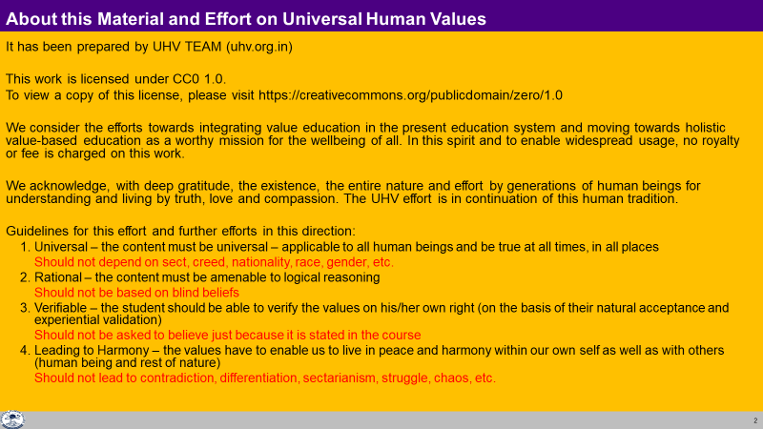

Slide 3
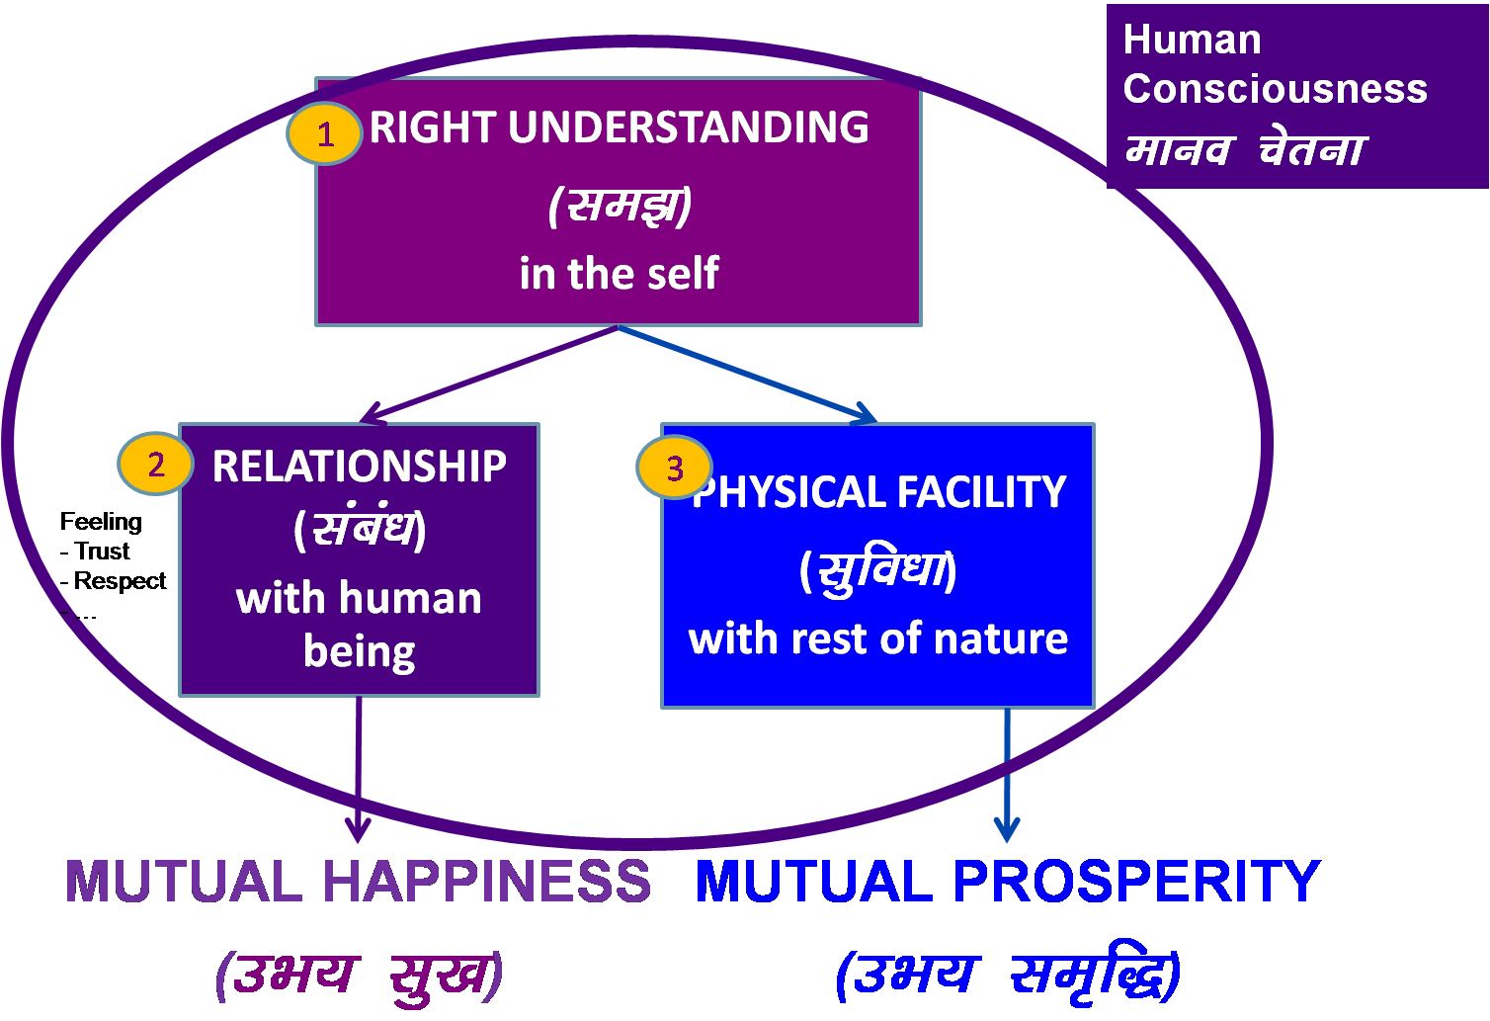
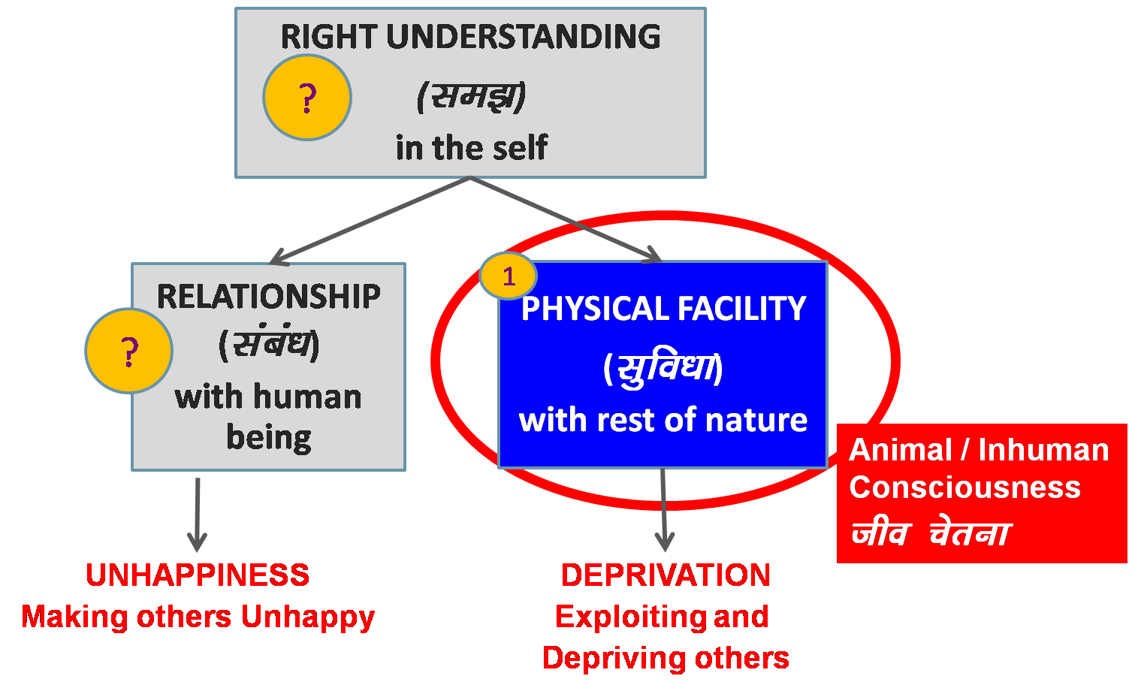
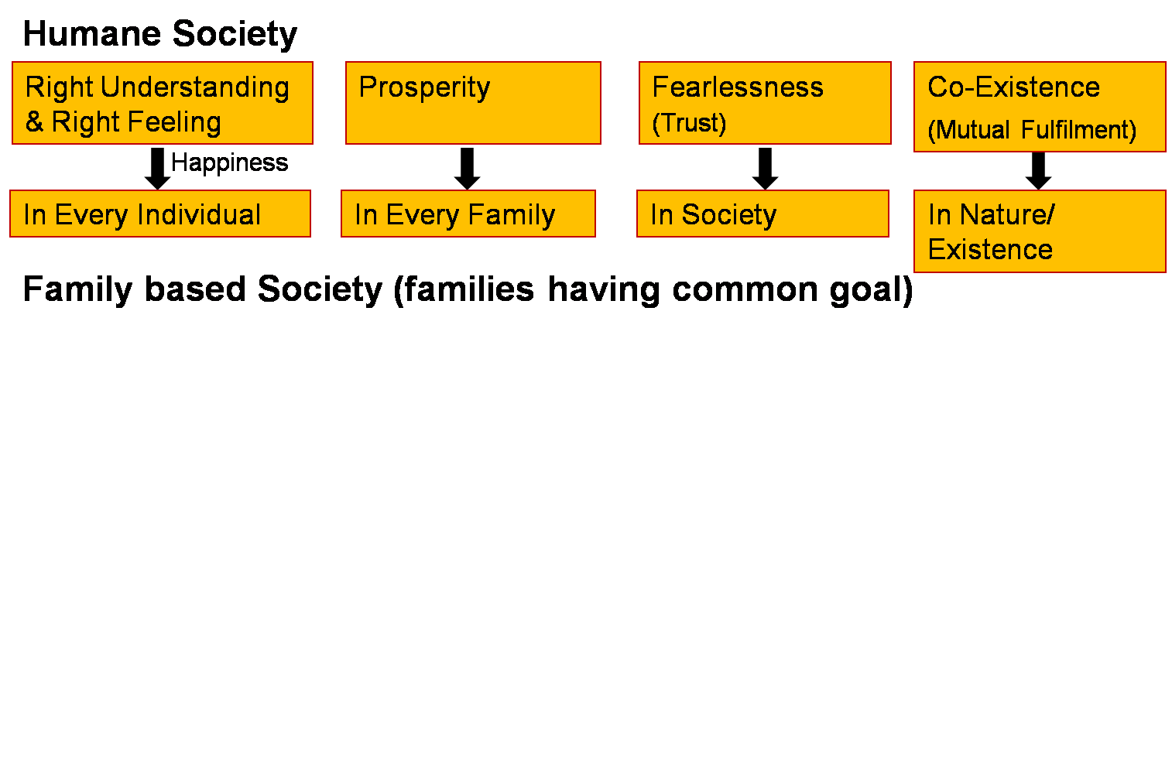
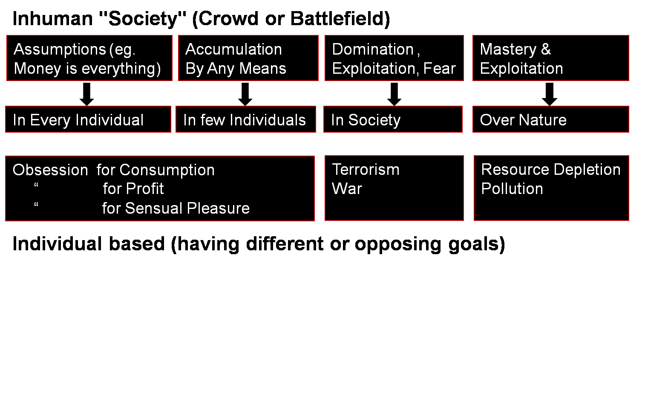
Transformation& Progress
laØe.k&fodkl

Slide 4

1972 - The Club of Rome publishes "Limits to Growth"
The Club of Rome publishes "Limits to Growth". The report is extremely controversial because it predicts dire consequences if there is not a slowdown of "growth" (throughput of raw materials from nature) in 50 years (by 2022):
Environmental breakdown
Breakdown of human relationship – wars
Mental / psychological breakdown
By 2016
2016 was hottest year in India’s recorded history (>51 degrees C), global atmospheric CO2 > 400PPM, way beyond stable norm of 300PPM
Over 50% tax money spent globally on preparing for war
WHO statistics show increasing obesity (>30%), depression (>10%) & suicide rates (>0.1%) in developed countries

Slide 5
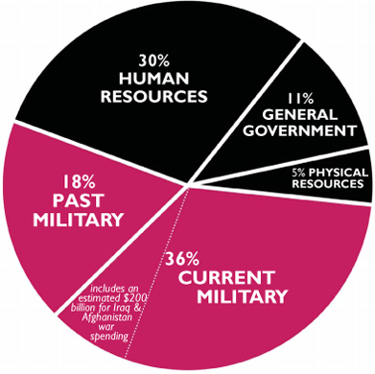
Total Outlays (Federal Funds): $2,650 billion
MILITARY: 54% and $1,449 billion
NON-MILITARY: 46% and $1,210 billion

Slide 6

1974 – Hunger is not a Scourge but a Scandal
Contrary to popular opinion, malnutrition and starvation are not the result of over-population, of poor climate or lack of cultivatable land.
The reason why hunger exists on such a vast scale is because world food supplies are controlled by the rich and powerful for the wealthy consumer.
Vested interests share responsibility for the fate of the poor.
Working with local elites & protected by the powerful they are gradually imposing control over the whole population.
This classic study of world hunger was written after the World Food Conference in 1974

Slide 7
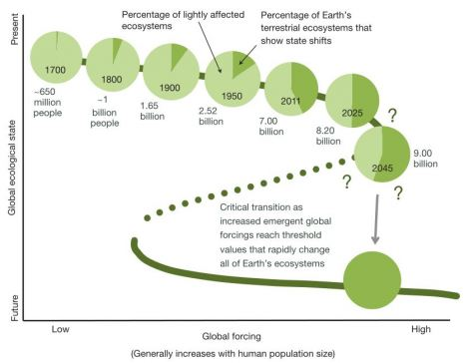
Approaching a state shift in Earth’s biosphere – NATURE June 2012
Human activity now dominates 43 percent of Earth’s land surface and affects twice that area.
One-third of all available fresh water is diverted to human use.
A full 20 percent of Earth’s net terrestrial primary production, the sheer volume of life produced on land every year, is harvested for human purposes.
Extinction rates compare to those recorded during the demise of dinosaurs.
Average temperatures will likely be higher in 2070 than at any point in human evolution.
http://www.nature.com/nature/journal/v486/n7401/full/nature11018.html

Slide 8
Problems
Human
Human-human relationship
Obesity, other diseases
Depression
Alcoholism, Drug abuse
Suicide
Population
Divorce
Societal breakdown
Terrorism
War
Human-rest of nature relationship
Atmospheric carbon (CO2…)
Soil fertility
Water insecurity
Seed for profit
Food insecurity
Breed for profit
Genetic manipulation for profit
Global warming
Climate change

Slide 9
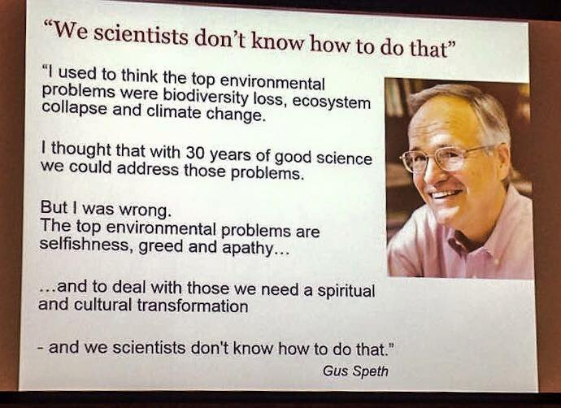

Slide 10
Atmospheric Carbon

Slide 11
We’re Running Out of Atmosphere (March 2012)
How Much Carbon in the Atmosphere is Too Much?
In last 650,000 years, CO2 levels nearly steady at 300 PPM
Greater than 350 parts per million CO2 is not compatible with the planet on which civilization developed and to which life on earth is adapted
Today, the atmosphere is 395 PPM of CO2
And rising at about 2 PPM per year
From climatologist Jim Hansen and his team at NASA. For more, see:
http://topdocumentaryfilms.com/great-global-warming-swindle/
http://www.ted.com/talks/james_hansen_why_i_must_speak_out_about_climate_change.html

Slide 12
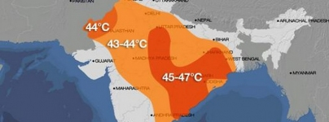
62 Year High Temperatures in India (+5 Degrees) by 25 May 2015
Severe heatwave breaks temperature records,
claims hundreds of lives across India
A red alert has been issued by Indian authorities after a severe heatwave left hundreds [estimated over 1000] of people dead across the country over the last ten days. Weather officials warn the heat will continue over the coming days and could get worse
States like Punjab, Haryana, Delhi, Uttarakhand and Uttar Pradesh may face drought
http://thewatchers.adorraeli.com/category/heat-wave/

Slide 13
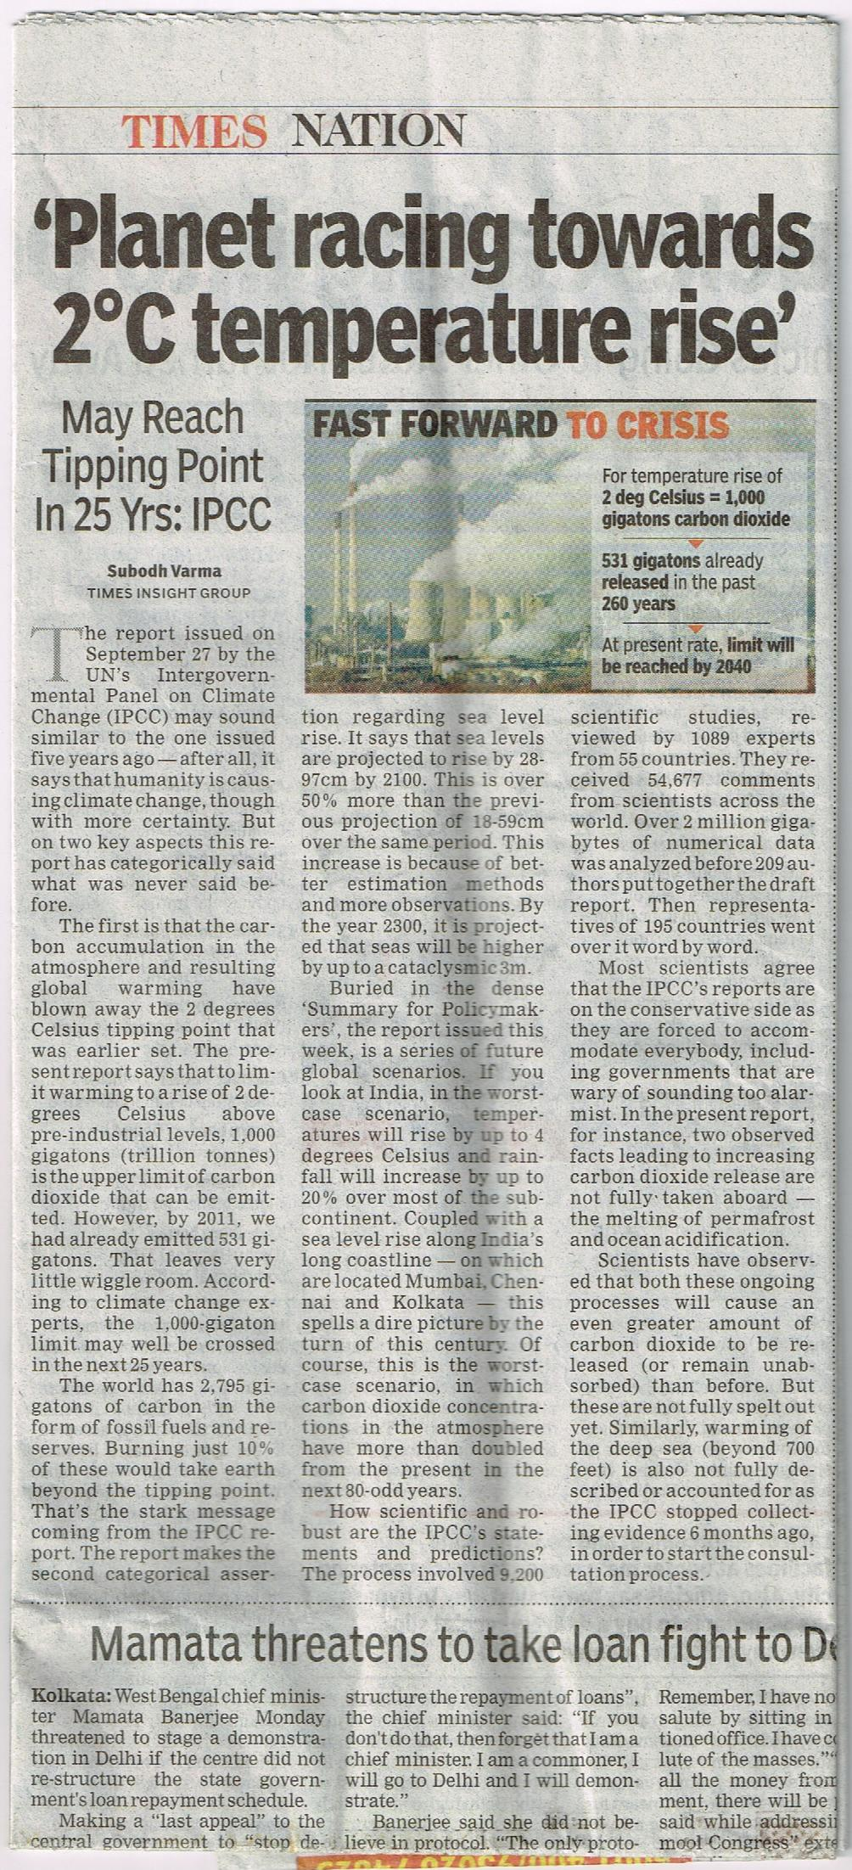
27-Sep-2013
Earth may reach tipping point by 2038
India outlook
4 deg temp rise
20% increase in rainfall
Sea level Rise
20’

Slide 14
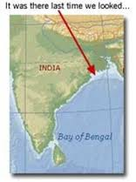
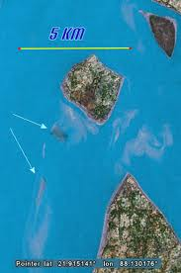
Disappearing islands of India – December 26th, 2006
Lohachara and Suparibhanga Islands
Once home to around 10,000 people, Lohachara island has slipped beneath the ocean and it’s neighbor, Suparibhanga island, met the same fate a while back.
http://www.greenlivingtips.com/eco-news/disappearing-islands-of-india.html

Slide 15
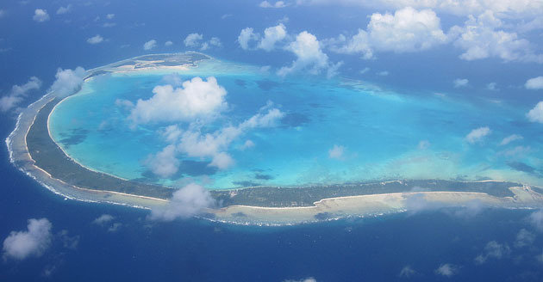
Island nation swallowed whole by the sea – 9th March 2012
The president of Kiribati, Anote Tong, is in desperate negotiations with the country of Fiji to find his nation (pop 110,000) a new, higher elevation home…

Slide 16
Related Videos
The Indoor Generation
https://youtu.be/TpwOrUTZdaY

Slide 17
Water Insecurity

Slide 18
Abundance of Natural Fresh Water Availability
India
3,287,590 km²
890 mm average rainfall
Total annual rainfall
2,925 cubic km
Total annual human water use
230 cubic km (urban + rural)
Water Storage
  Forest (tree roots) (max%)
  Glaciers (small%)
  Bauxite mountains (min%)
  Bogs, underground aquifers (433,000 cubic km)
  Lakes, ponds…
  Forests
Natural distribution of water
  Rain
  Rivers & Streams overground (also distributes silt, fish…)
  Rivers & Streams underground

Slide 19
Water Status – Mismanagement
India
3,287,590 km²
890 mm average rainfall (has become erratic)
Total annual rainfall
2,925 cubic km (59% in 2014)
Total annual human water
230 cubic km (urban + rural)
  (increasing indiscriminate use in urban areas,
  dumping of waste in rivers, ground...,
  chemical farming, heavy machinery,
  reduced bio-diversity...)
Water Storage
  Forests (deforestation)
  Glaciers (melting rapidly)
  Areas with bauxite (mining)
  Bogs, underground aquifers (433,000 cubic km) (30% dry)
  Lakes, ponds… (filled up)
Natural distribution of water
  Rain (disturbed)
  Rivers (both over & under ground disturbed)
Unnatural storage & distribution of water
  Dams
  Canals

Slide 20
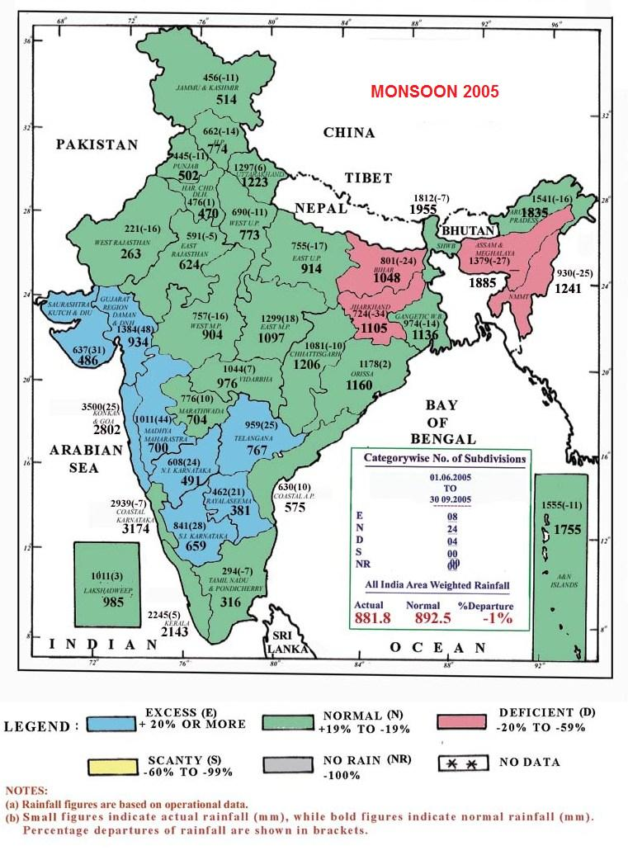
Source:
http://www.google.co.in/imgres?imgurl=http://www.imd.gov.in/section/hydro/dynamic/rfmaps/daily.jpg&imgrefurl=http://www.imd.gov.in/section/nhac/dynamic/Monsoon_frame.htm&usg=__sVXANG39JRtVwaaMYvgMj-YlC14=&h=1055&w=826&sz=643&hl=en&start=1&zoom=1&tbnid=Fnold1FLRPAntM:&tbnh=137&tbnw=107&ei=uLBnUNaaPMLhrAewqYCgCQ&prev=/search%3Fq%3Drainfall%2Bin%2Bindia%2B2012%26tbnh%3D146%26tbnw%3D114%26hl%3Den%26sa%3DX%26sig%3D114368509476594328795%26biw%3D800%26bih%3D509%26tbs%3Dsimg:CAQSEgkDlEl3RO_1WtCFsr0eOvAQFTA%26tbm%3Disch%26prmd%3Dimvns&itbs=1&iact=hc&vpx=97&vpy=40&dur=5062&hovh=254&hovw=199&tx=123&ty=199&sig=114368509476594328795&page=1&ved=1t:429,r:0,s:0,i:50

Slide 21
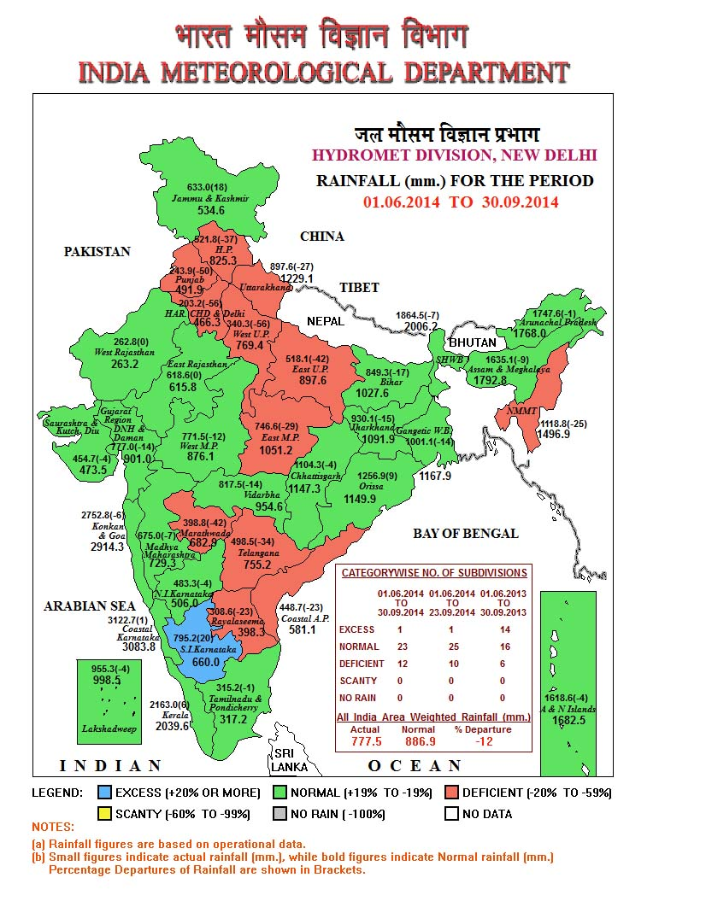

Slide 22
Areas with maximum underground water over-use (red areas) also have poor rainfall
E.g. Delhi
water table has fallen > 4 m 1997-2006
In 2013
5,723 ground water blocks in the country
1,615 or 29% classified as semi-critical, critical or overexploited
60% of aquifers in India will be in a critical condition by 2028 if the trend of indiscriminate exploitation of ground water continues

Slide 23
India's Ground Water Table to Dry Up in 15 years (DH March 2013)
India's estimated use of ground water = 230 cubic km annually
  60% of irrigated agriculture
  80% of rural and urban water supplies
5,723 ground water blocks in the country
1,615 or 29% classified as semi-critical, critical or overexploited
60% of aquifers in India will be in a critical condition by 2028 if the trend of indiscriminate exploitation of ground water continues
Grounwater hold capacity is estimated to be 433 billion cubic meters
World Bank report calls for immediate corrective measures
http://www.deccanherald.com/content/56673/indias-ground-water-table-dry.html

Slide 24
Food Insecurity

Slide 25
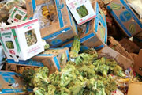
FAO Report – 11-May-2011
Of the 4.2 billion tons of food produced, more than 1 billion tons of food is lost or wasted every year, UN-backed report finds (11 May 2011)
About a third of all the food produced for human consumption each year – or roughly 1.3 billion tons – is lost or wasted, according to a new study commissioned by the United Nations Food and Agriculture Organization (FAO)
Global Food Production is 6 times requirement
Global Food Wastage is 1/3rd of production
Wastage is enough to feed 1300 crore people/year
Have we understood right utilisation?
Is it a question of production?
Is it a question of relationship?
Is it a question of right understanding?
It is a question of right education-sanskar
http://www.un.org/apps/news/story.asp?NewsID=38344&Cr=fao&Cr1

Slide 26
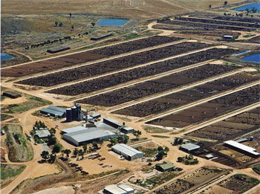
Even Small Individual Choices Add Up. E.g. Choice of Food
20% of all life produced on land every year is harvested for human purposes
14-16 kg grain & 21,000 litres of water → 1 kg meat
The world's cattle alone (not including other livestock) annually consume food grains enough for 8.7 billion people
Land use – 3¼ acres/person on meat diet vs 0.2 acres/person on veg diet
20% Amazon rain forest (the size of California) destroyed since 1970
80% of this land is used for cattle raising
By feeding grain to livestock, we lose 90% of the protein, 96% of the calories, 99% of its carbohydrates, and 100% of the fiber. Animal-based diets are high in saturated fat, excessive protein and cholesterol, leading to heart disease and stroke (nearly 50% of all deaths in the US)
Video (1 min)
http://www.planetaryrenewal.org/ipr/vegetarian.html

Slide 27
Human Population

Slide 28
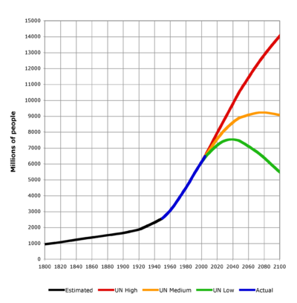
Population
Obsession for sensual pleasure (Kaam Unmad)
Breakdown of human relationship (Village Family → Joint Family → Nuclear Family → Individual → Split Personailty …)
Modern Medical Science
    Lower infant mortality
    Longer Lifespan
    Healthier?
Small Family & Long Life VIDEO
World Population Extrapolation VIDEO
  World population from 1800 to 2100
  Source: http://en.wikipedia.org/wiki/World_population

Slide 29
  The problem is not – just the population
  The problem is – population without right understanding

Slide 30
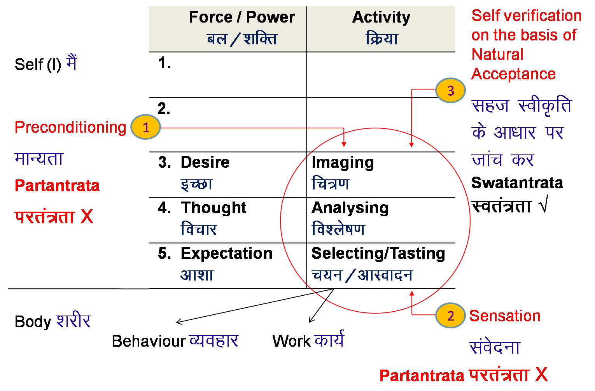
3.1.1. Knowledge of HB– Comparing (Basis for Analysing)
Appealing
to Senses
Conducive to Health
Profit
able
Un-guided
(or under the influence of
Preconditioning, Sensation)
Obsession for Sensation
Obsession for Indulgence
Obsession for
Profit
(Sound, Touch, Sight, Taste, Smell)

Slide 31
Holistic Approach

Slide 32
Current Approach Work to be Done in Society
Problem – Population, water scarcity,
Our way of thinking…
(or only symptom?)
Action taken to get rid of it – Technology…
(or symptomatic relief – Temporary?)
Clarity of All Encompassing Solution (Samadhan)
2. Effort for All Encompassing Solution
Human Education,
Human Conduct,
Human Constitution,
Human Order
3. Problem – Analysis in the light of Samadhan – Inhuman Conduct (exploitation of nature, domination… are only the symptoms)
4. Effort for getting rid of problem – Ensure Human Conduct through Human Education

Slide 33
Managing Water

Slide 34
Some Efforts Within Existing System: About Water & Food
Farmland/Village
Natural Farming (E.g. Maharashtra – Subhash Sharma)
Grassland
Reversing Desertification (E.g. 15 mn hectares on 5 continents – Allan Savory) Video (18 mins)
Forest & Wetland
Contribute to its right utilisation, protection and enrichment
or just leave it to nature
Desert
Water Management (E.g. Rajasthan – Anupam Mishra)
Urban Settlement
Water harvesting (E.g. Karnataka – Vijayanagar, Bengaluru)

Slide 35
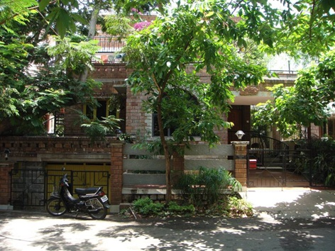
Example of a Study Project in dimension 3-production-work
"Sourabha" is located in southwestern part of Bangalore (Vijayanagar). Plot area is 2400 Sq. ft. (40 ft. x 60 ft.)
Constructed 1995
Entirely dependent on rainwater for all its needs since 1994
(including construction)
No Corporation or BWSSB water connection ever
Rainfall ~1000 mm/year
Collection ~2,23,000 lts/year
Need ~1,80,000 lts/year
Recharges Ground Water
http://kscst.org.in/rwh_files/rwh_sourabha.html

Slide 36
Videos
Societal Breakdown: Economics of Happiness (1 hr 9 min)
Efforts for Reversing Desertification, Allen Savory (23 min)

Slide 37
Example of Efforts for Preserving Nature

Slide 38

Our Role in Sustaining Harmony in the Nature
Value education and awareness for the masses
Value based living (free of obsession of consumption, profit and sensual pleasure, accumulation, domination, exploitation, wars etc.)
Walking and cycling to the extent possible in our daily life
Planting trees, reforestation and afforestation
Protecting areas such as national parks and wildlife reserves, to conserve ecosystems and protect biodiversity
Water harvesting
Restoring wetlands
Preserving rivers
Sustainable agricultural practices
Nurturing species of birds and animals
Stopping poaching of animals
Reduce, Recycle, Reuse
Use of renewable material and energy
*There are several examples of governments, people and organizations working for the above cause too.

Slide 39
Typical Examples of Efforts in this Direction
A person making nests for lacs of birds
A person planting thousands of trees
A person restoring rivulets
A person restoring the water table in thousand of acres of land
People of a country cycling mostly and roads and pavements being made accordingly
Watershed programs, river restoration and other preservation efforts (e.g. wildlife) of the Governments around the world
Efforts by various organizations and companies for reforestation and afforestation
Water harvesting in the cities
Campaigns to stop use of one-time use plastic
Efforts for making eco-friendly houses
…

Slide 40
Reversing Desertification
Allen Savory videos

Slide 41
Efforts by UHV Volunteers
A short 17-min film in Marathi with English subtitles on the initiative of Natural Farming/Production and Cooperative distribution of fresh natural (organic) produce to 1000 families in Pune by Pratibha and Mahesh Kolte of Pune
https://youtu.be/mzuR3Dd3I9E
A 2019 article in Times of India
https://timesofindia.indiatimes.com/city/pune/universe-seeker-to-clean-eating-advocate-astrophysicist-promotes-natural-farming/articleshow/72430717.cms

